Slide 1
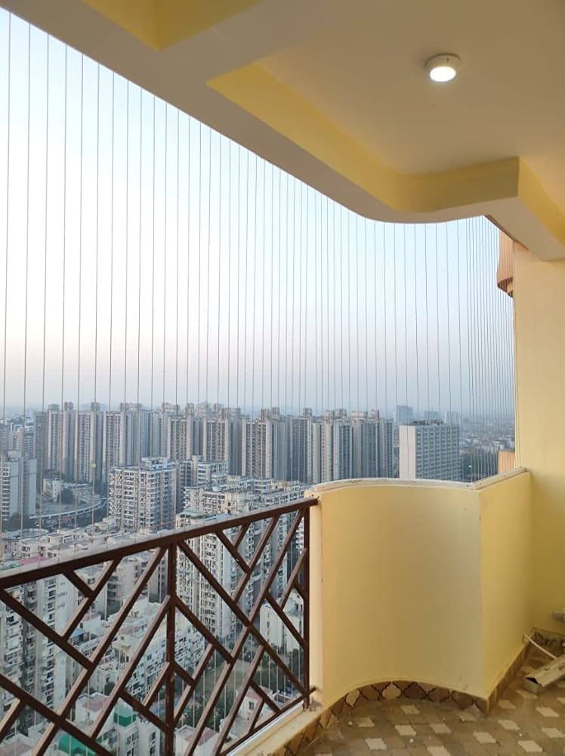

Invisible Grill
Invisible Grill
https://4by8.in/
Sales & Installation call :7347701410

Slide 2
About 4by8
We are a retail hub and online portal for all kinds of Quality Tiles, Sanitary ware, Plumbing and Chrome plated fittings and household installation works.
4by8 state of art products ensures to maintain your aesthetic supremacy in your household and workplace. A brand new range of assorted products keeps you up with the latest trends and designs in the market.

Slide 3
Invisible Grill for Balconies and Windows in Premium Safety Without Obstruction
Our high-quality, made-to-measure invisible grill system offers a modern safety solution that protects your home without blocking your view. Ideal for apartments, villas, and multi - storey buildings across India, this durable stainless steel system combines safety, strength, and sleek aesthetics.
Why Choose Our Invisible Grills
Enhances balcony and window safety for families with children and pets
Built to withstand Indian weather conditions including heat, humidity, and rain
Sleek, minimalistic appearance – maintains the view and architectural aesthetics
Cannot be easily cut or tampered with – adds a layer of home security
Professionally installed with custom measurements for a perfect fit
Low maintenance, long-lasting performance in Indian environments

Slide 4
Features & Specification
Wire
Wire Thickness Options: 2.5 & 3.5 4.0 MM for superior strength and tension
Wire Spacing Choices: 2 inch to 4 inch cm, based on your safety requirements
Material: Premium 304/316/316P-grade stainless steel – coated with Nylon rust-proof and corrosion-resistant
Color: Neutral silver finish to blend with all home styles
Frame
Aluminum tracks comes with 2.5 ,3.5,4.0 with powder coated
Usage
Suitable for both indoor and outdoor applications (balconies, windows, staircases)

Slide 5
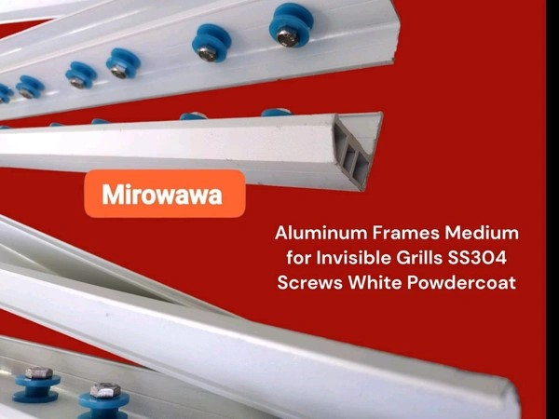
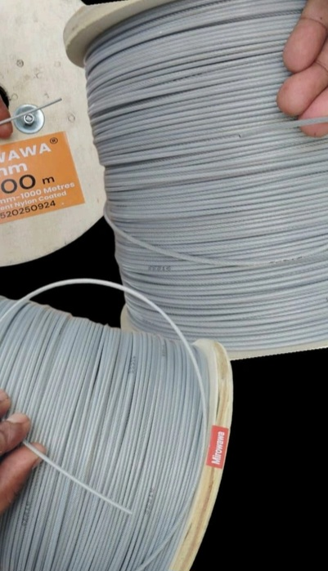
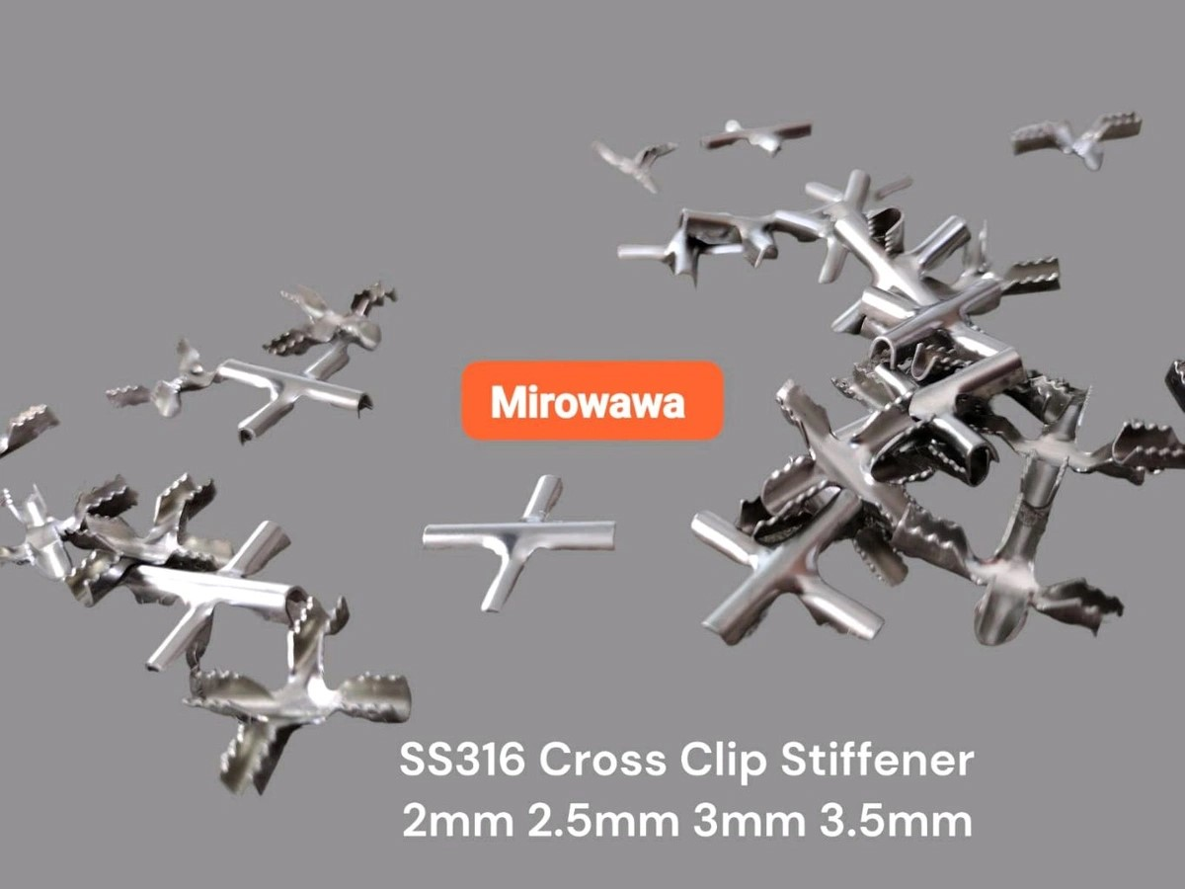
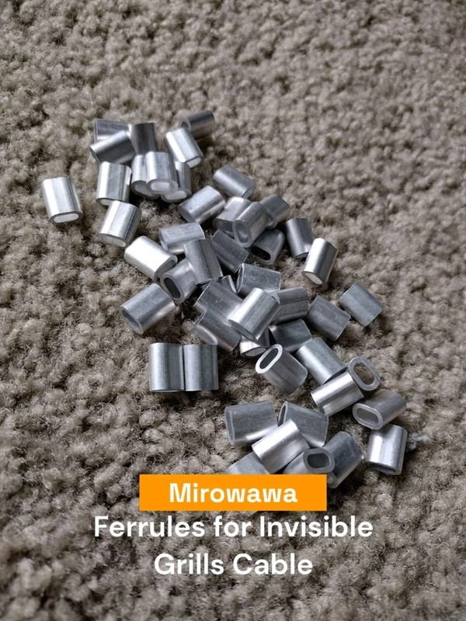

Frame, Wire, Stiffener , ferrules, Hex head frame fixing screw

Slide 6
Installation Process
This is a custom-installation product available across India. Our team will schedule a free site visit to take measurements and provide expert recommendations. Installation is clean, fast, and meets local safety guidelines.
Note: Product images are for reference only. Final appearance may vary based on your building’s layout and structure.
Location
Plot # 81, Phase 2,Marble Market, Kalamboli, Navi – Mumbai – 410218
Sales & Installation call :734 77 01 410

